Slide 1
Geodata September 2022 Group H
Fundamentals of Geodata Management Systems
Ziad helou
29926

Slide 2
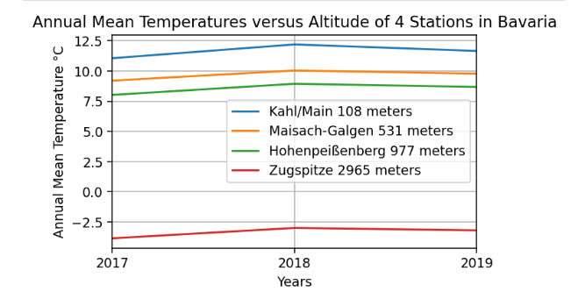
Task01: Verifying the hypothesis: "In the troposphere the mean annual temperature decreases approximately linearly with height."

Slide 3
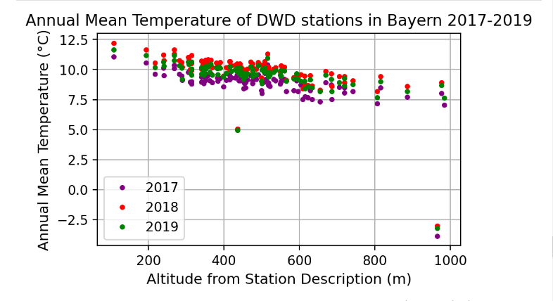
Sub-Task 1.1: Plotting the annual mean temperatures of years 2017, 2018, and 2019 vs altitude for the DWD stations in Bavaria in one diagram

Slide 4
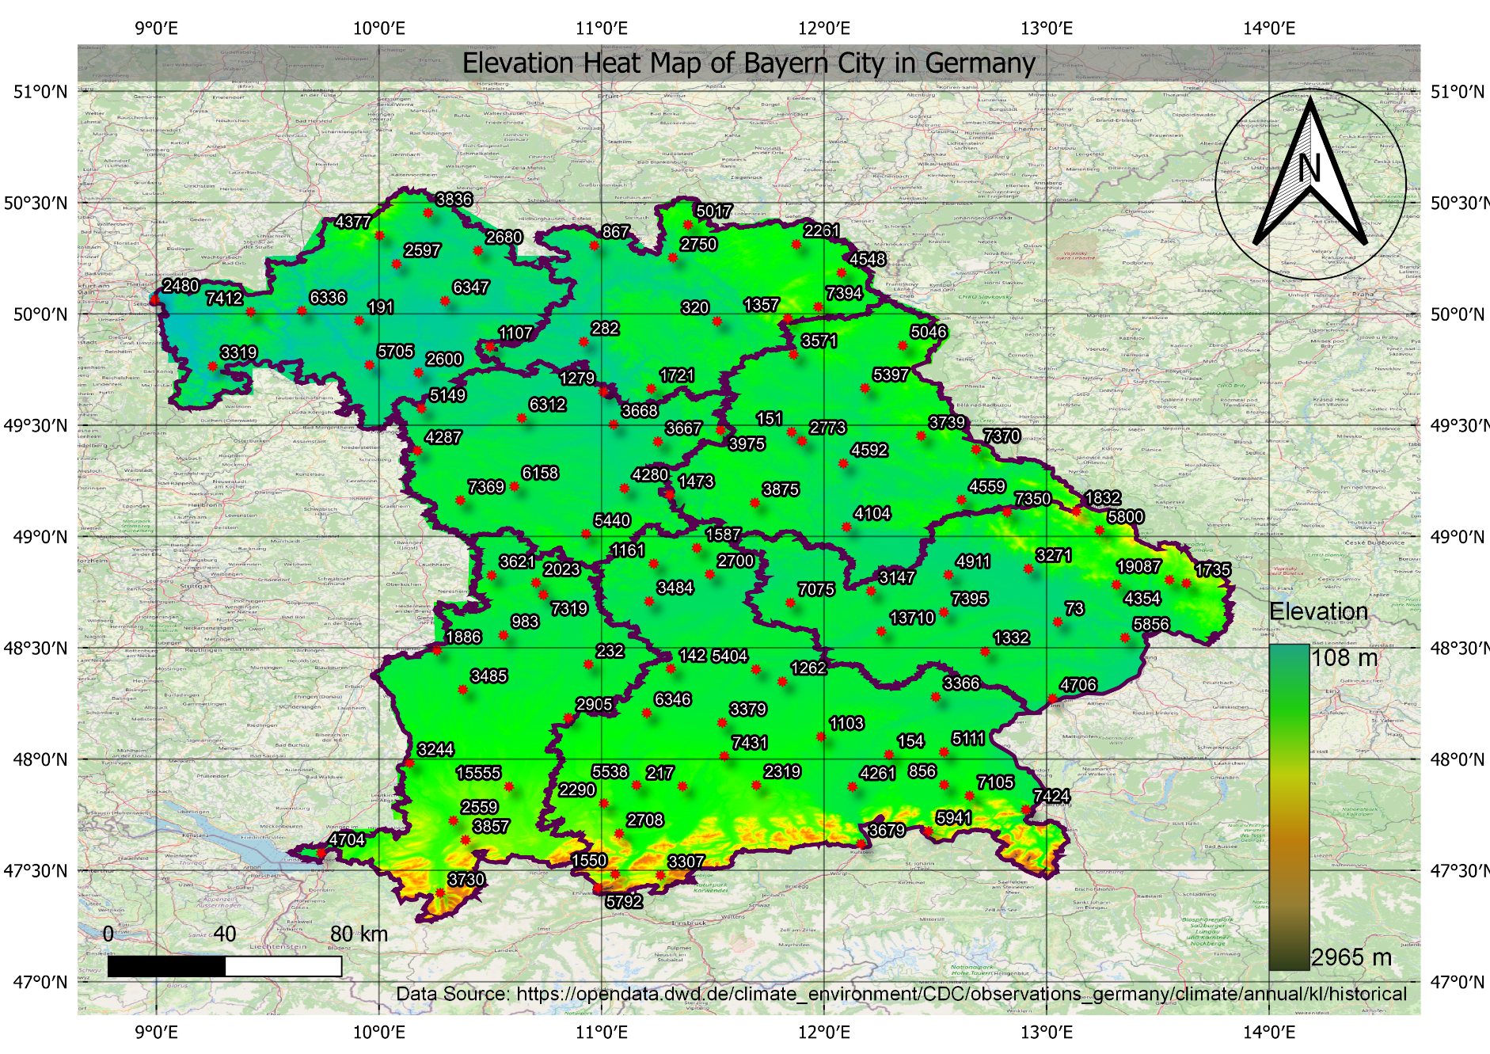
Sub-Task 1.2: Create a decent map with all DWD temperature stations in Bavaria which were active in the years of concern (2017, 2018, 2019).

Slide 5
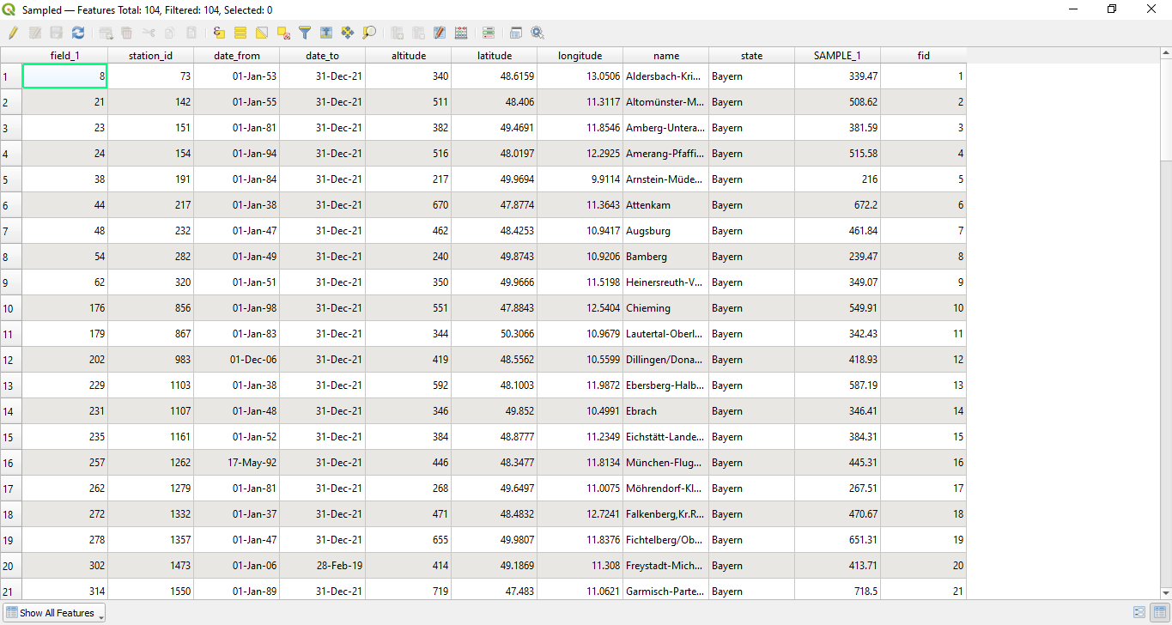
Sub-Task 1.3: Sample the DTM at the locations of the DWD stations.

Slide 6
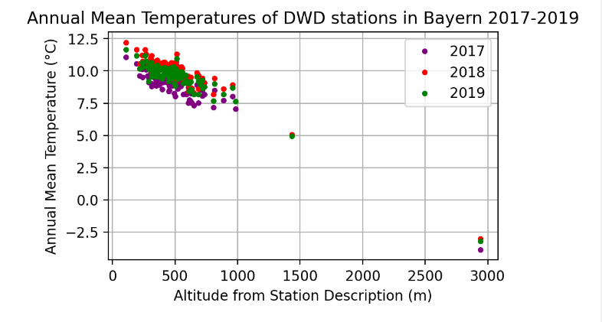
Sub-Task 1.4: Plot the mean annual temperatures versus the DTM heights for the DWD stations in Bavaria. Perform a linear regression with Numpy to the data

Slide 7
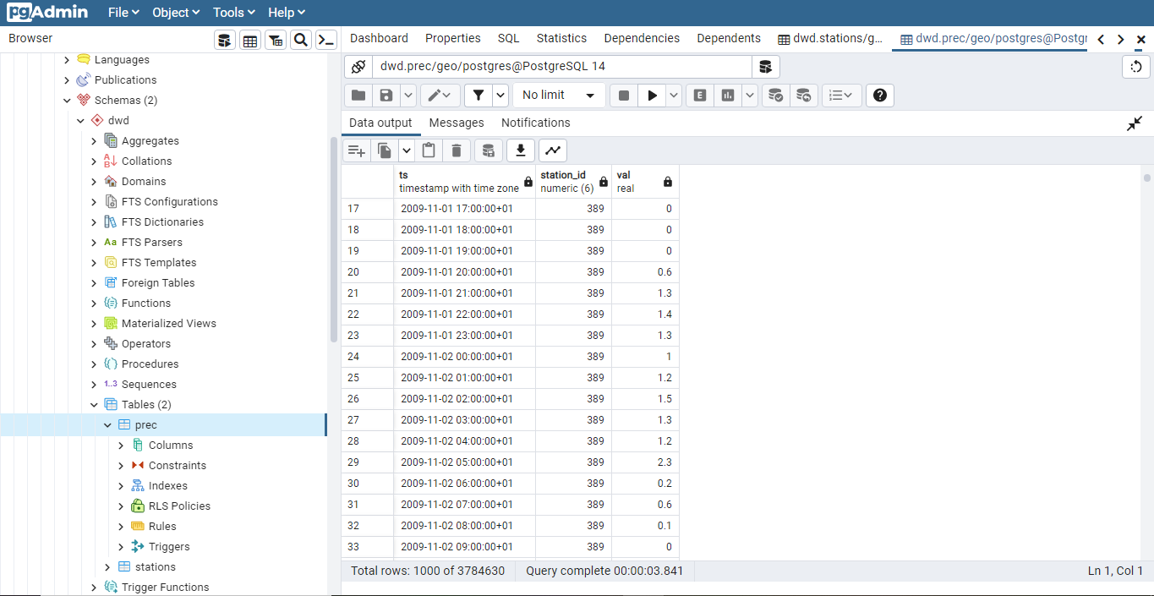
Sub-Task 2.1: Create and fill your own geodatabase with DWD precipitation station data as well as hourly precipitation time series.

Slide 8
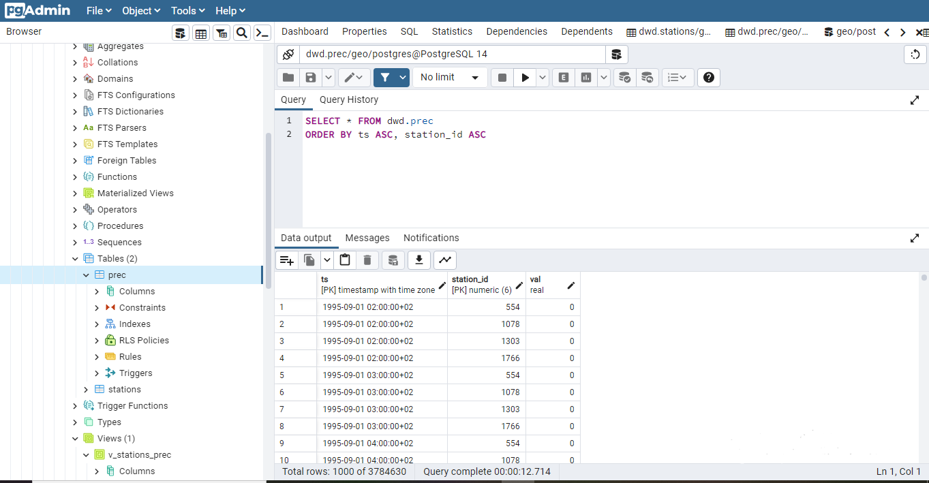
Sub-Task 2.1: Create and fill your own geodatabase with DWD precipitation station data as well as hourly precipitation time series.

Slide 9
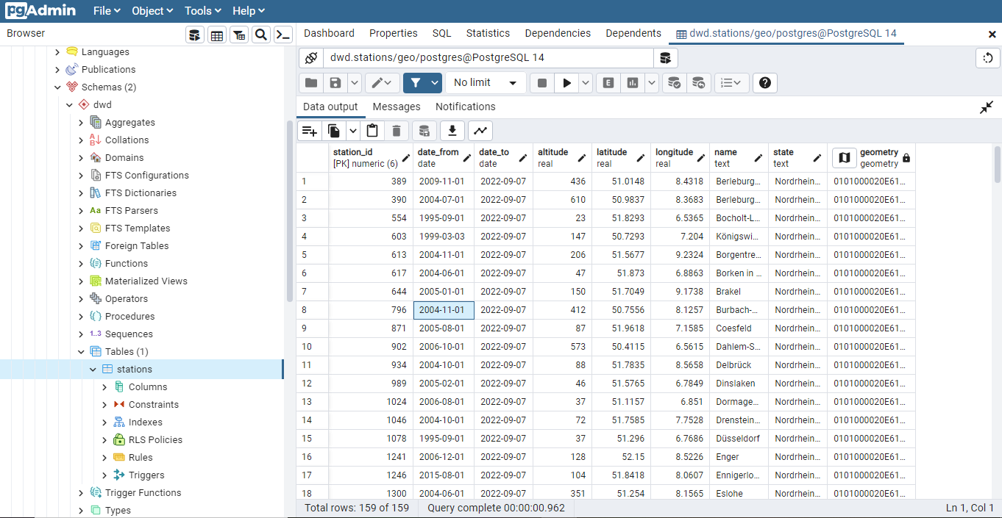
Sub-Task 2.1: Create and fill your own geodatabase with DWD precipitation station data as well as hourly precipitation time series.

Slide 10
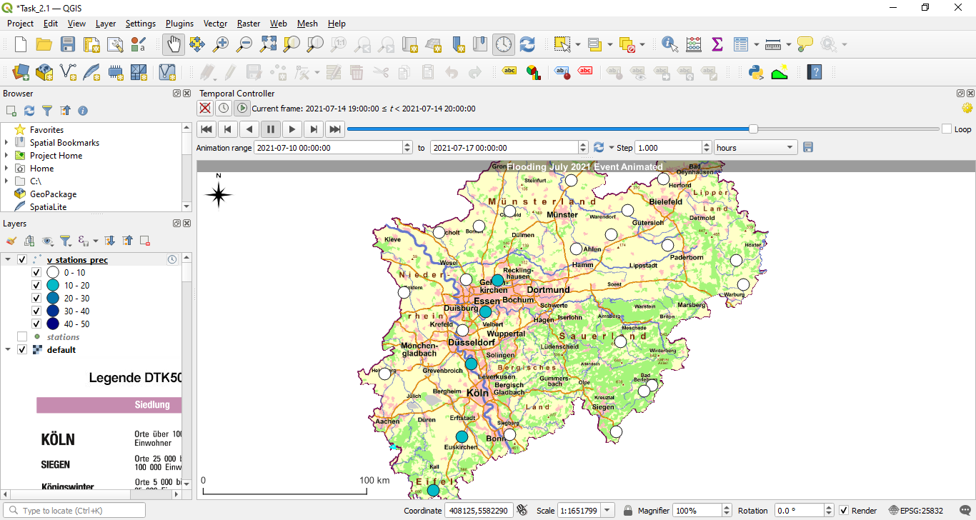
Sub-Task 2.2: Add the PostGIS view v_stations_prec as a layer to your QGIS project Sub-Task 2.3: Use the QGIS Temporal Controller to produce an animation

Slide 11
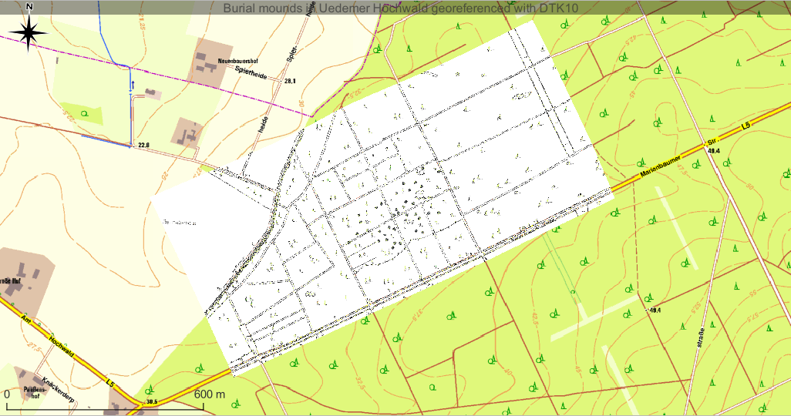
Sub-Task 3.1: Georeference the picture of the map above.

Slide 12
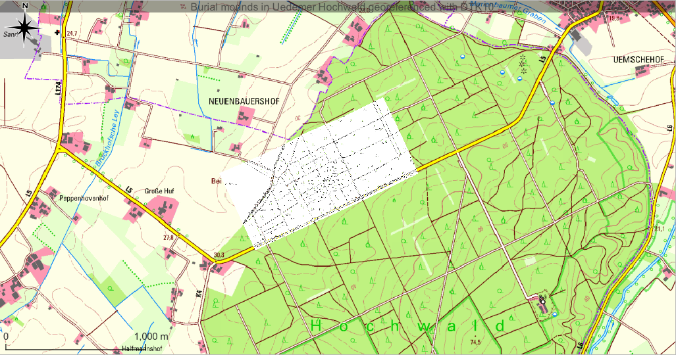
Sub-Task 3.1: Georeference the picture of the map above.

Slide 13
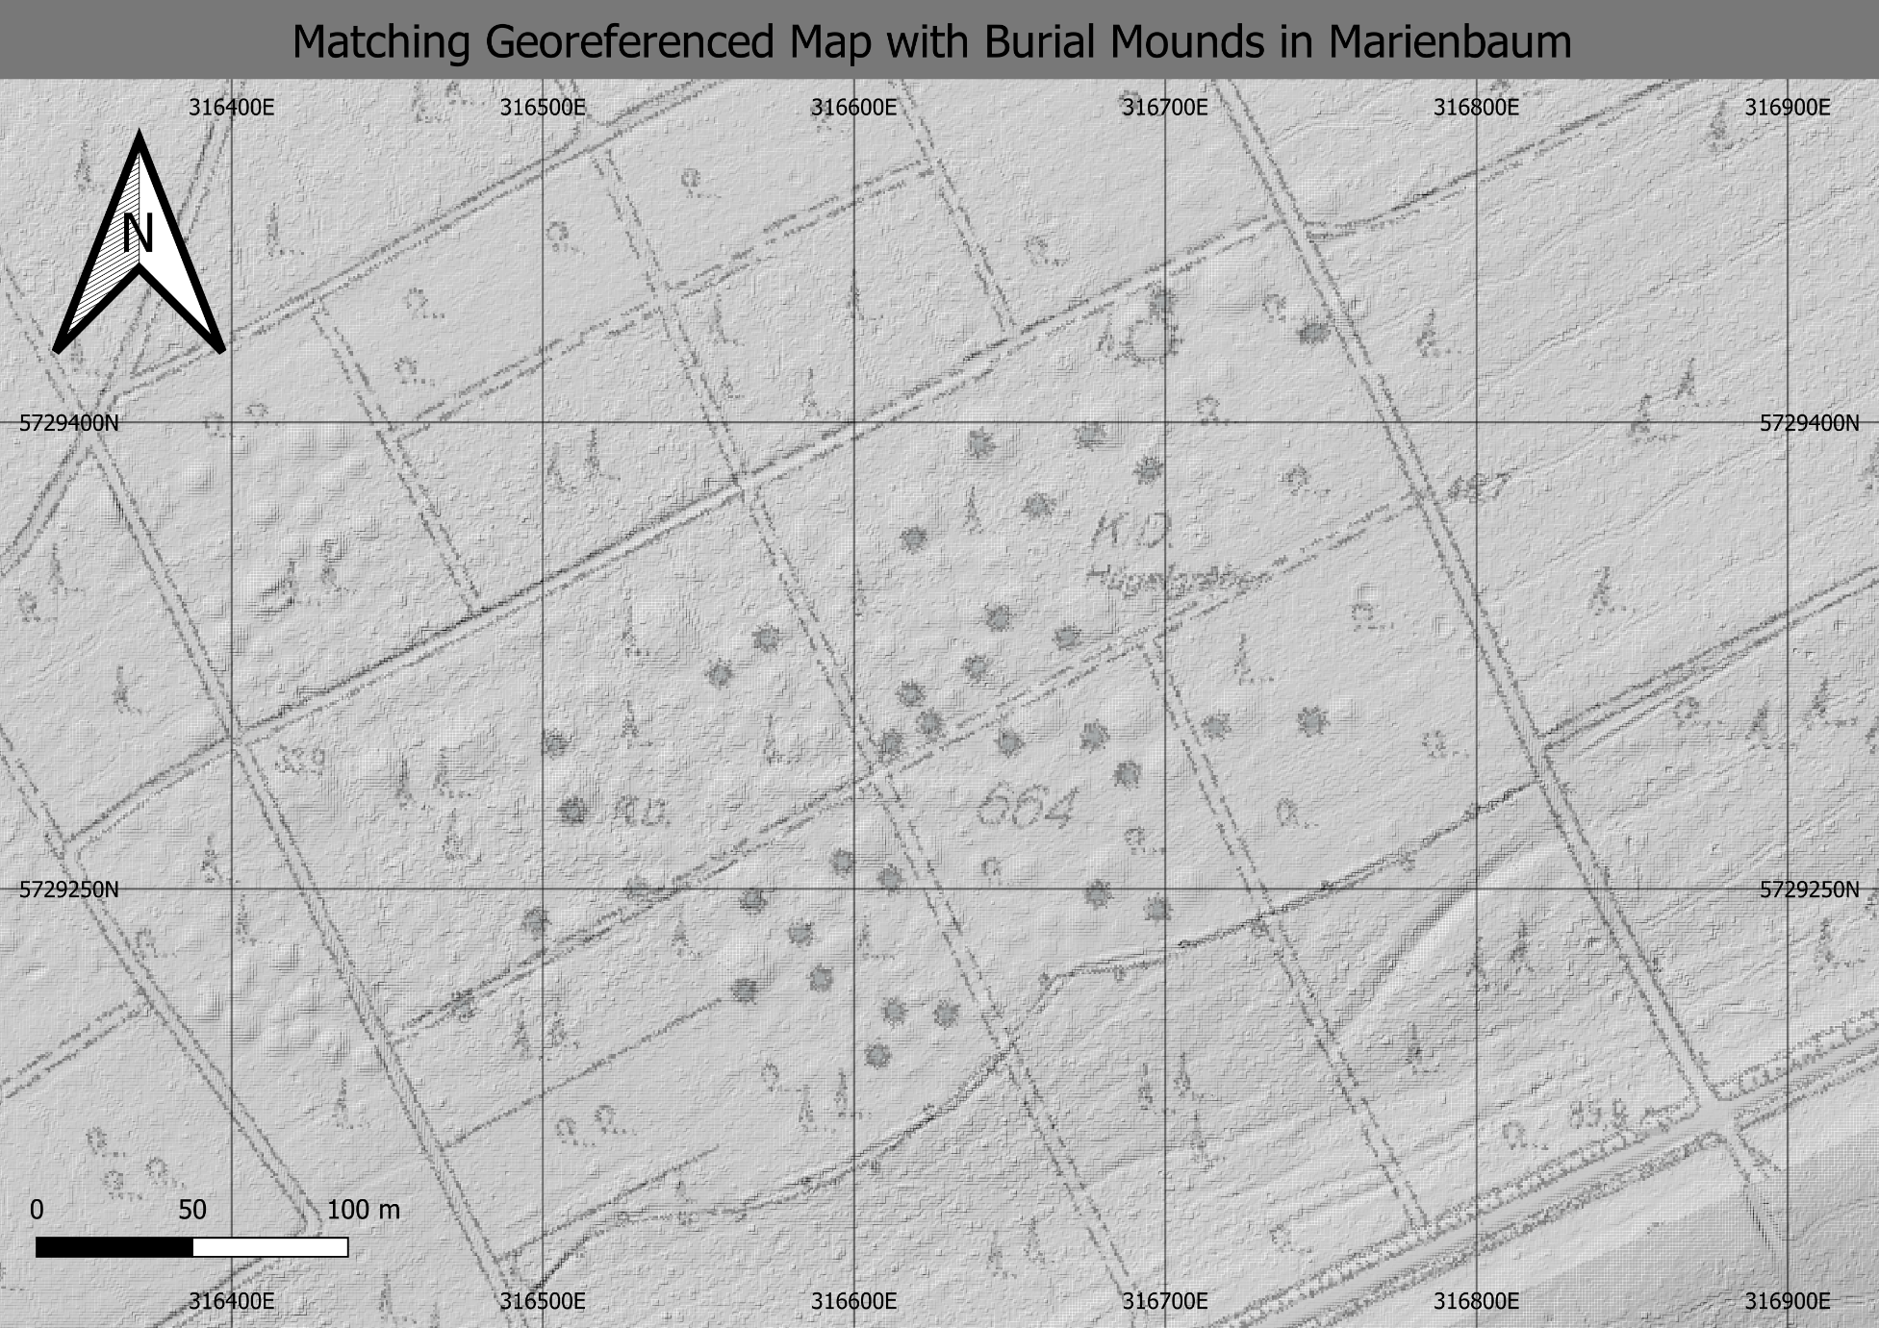
Sub-Task 3.2: Create a hillshade model from the DTM layer. Plot your georeferenced map partly transparent on top of the hillshade model.

Slide 14
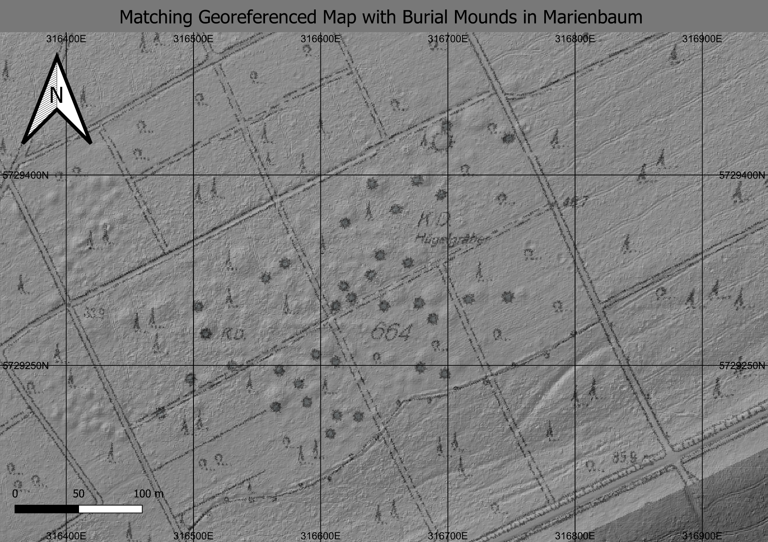
Sub-Task 3.2: Create a hillshade model from the DTM layer. Plot your georeferenced map partly transparent on top of the hillshade model.

Slide 15
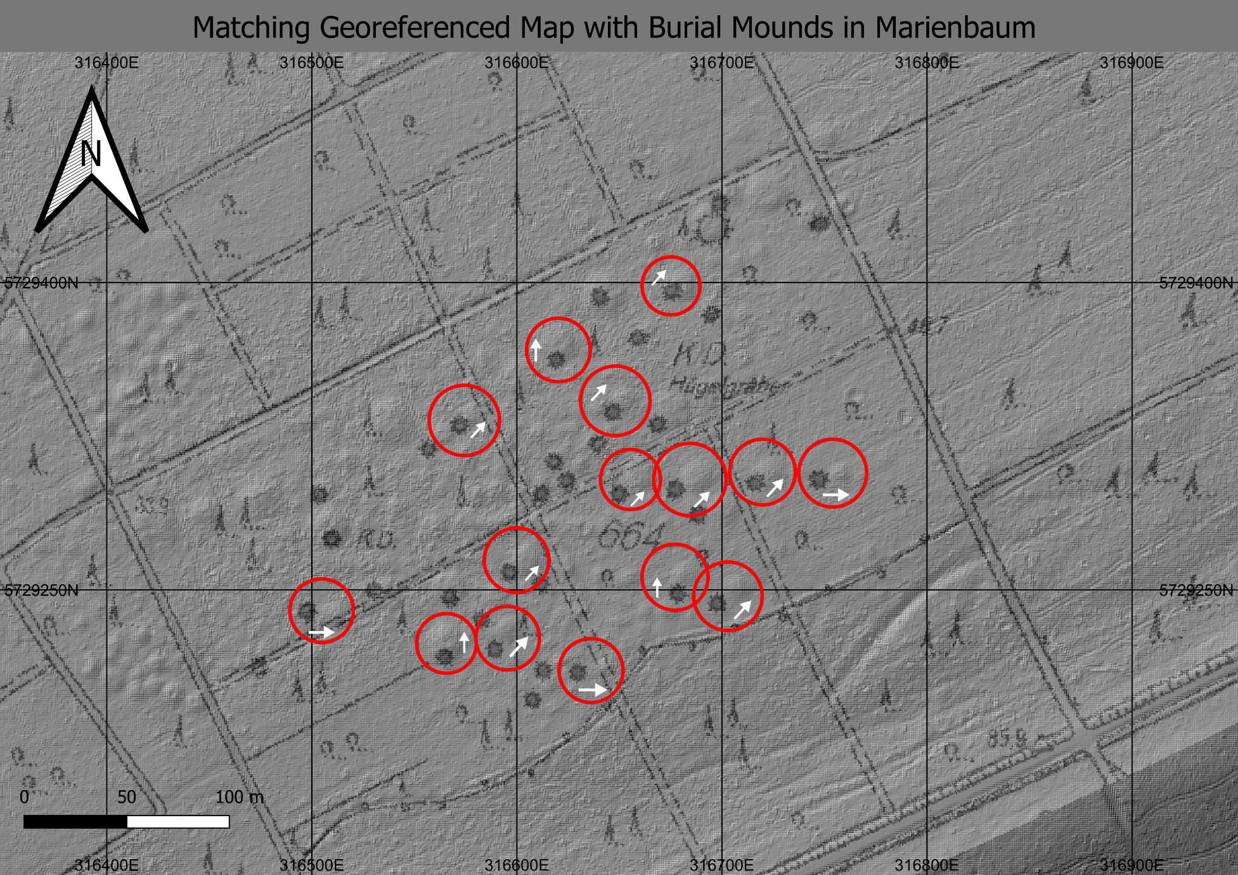
Sub-Task 3.2: Create a hillshade model from the DTM layer. Plot your georeferenced map partly transparent on top of the hillshade model.

Slide 16
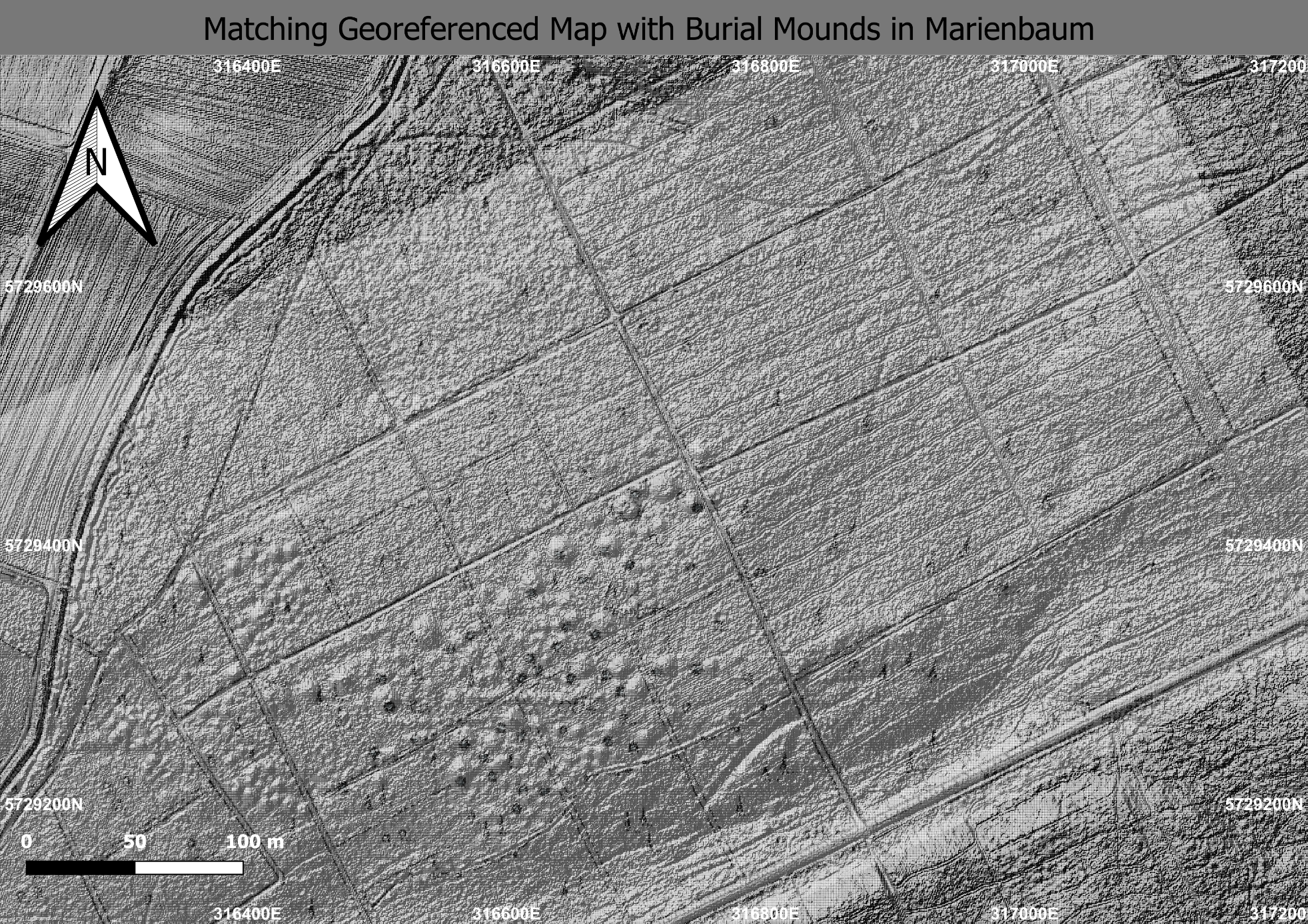
Sub-Task 3.2: Create a hillshade model from the DTM layer. Plot your georeferenced map partly transparent on top of the hillshade model.

Slide 17
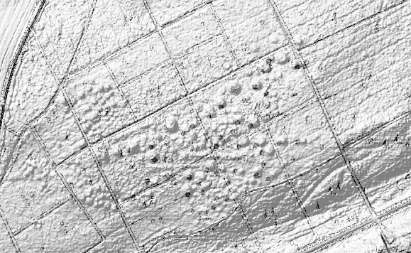
Sub-Task 3.2: Create a hillshade model from the DTM layer. Plot your georeferenced map partly transparent on top of the hillshade model.

Slide 18
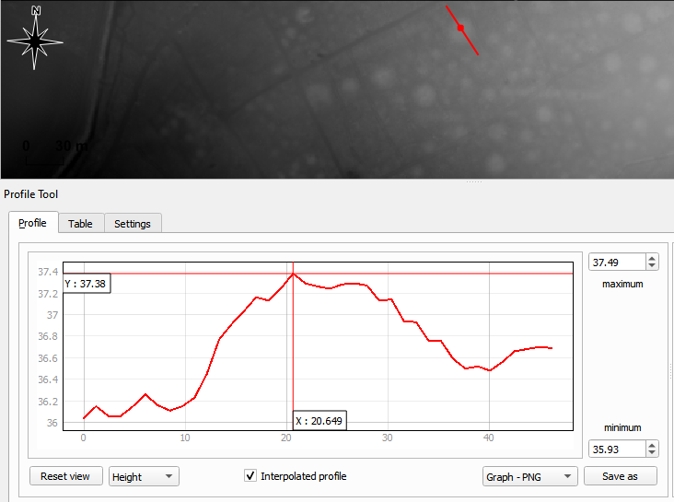
Sub-Task 3.3: Use the DTM and measure the typical mound heights relative to their direct environment/neighborhood. What is their typical elvation in the landscape?

Slide 19
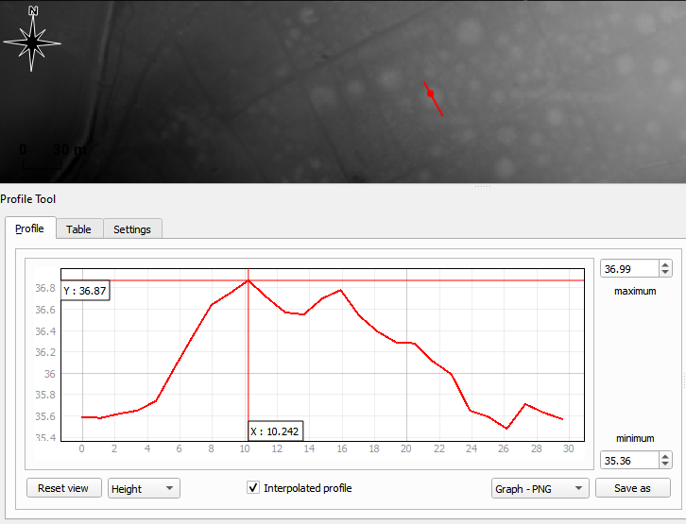
Sub-Task 3.3: Use the DTM and measure the typical mound heights relative to their direct environment/neighborhood. What is their typical elvation in the landscape?

Slide 20
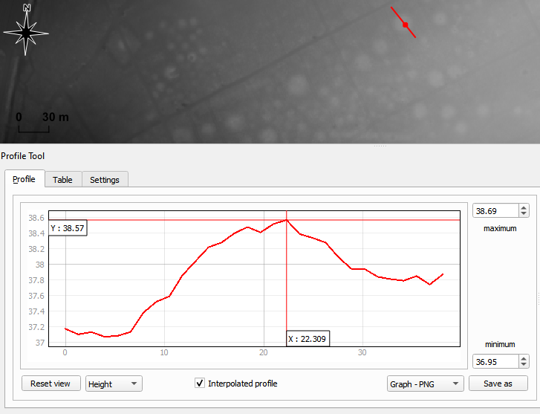
Sub-Task 3.3: Use the DTM and measure the typical mound heights relative to their direct environment/neighborhood. What is their typical elvation in the landscape?

Slide 21
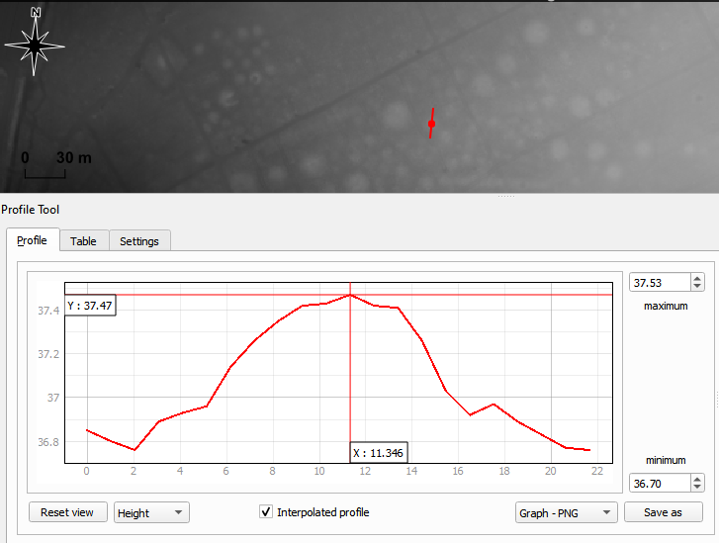
Sub-Task 3.3: Use the DTM and measure the typical mound heights relative to their direct environment/neighborhood. What is their typical elvation in the landscape?

Slide 22
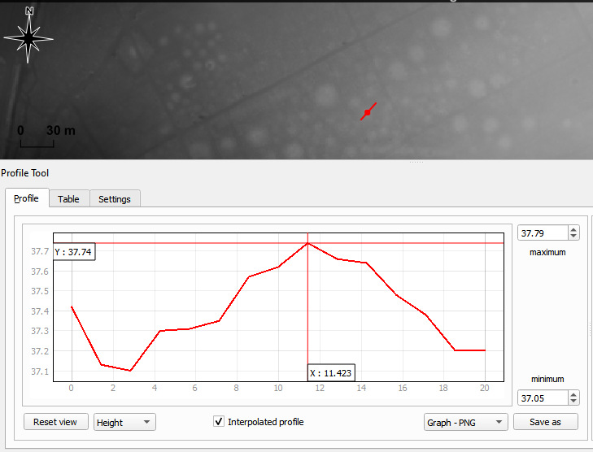
Sub-Task 3.3: Use the DTM and measure the typical mound heights relative to their direct environment/neighborhood. What is their typical elvation in the landscape?

Slide 23
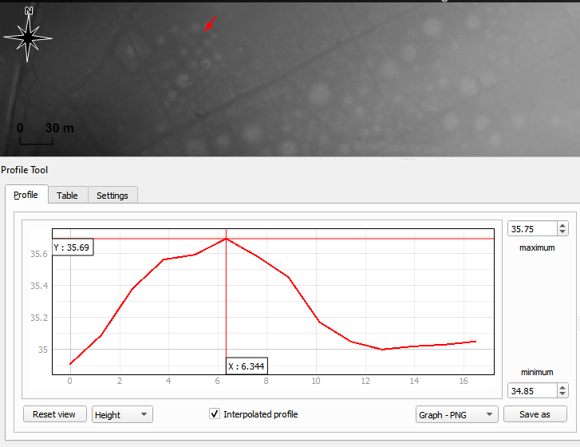
Sub-Task 3.3: Use the DTM and measure the typical mound heights relative to their direct environment/neighborhood. What is their typical elvation in the landscape?

Slide 24
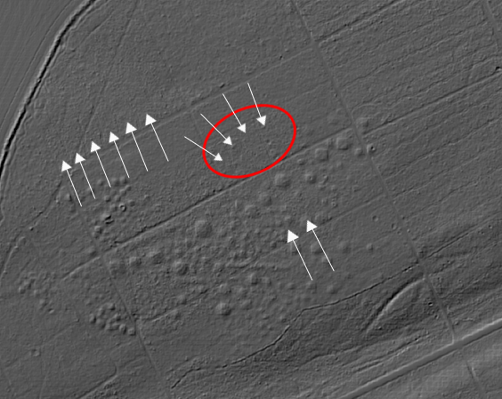
Sub-Task 3.4: Study the hillshade model in direction East-North-East of the burial mounds area and search for weakly visible rectangular structures which are not paths. Choose at least one of the structures, digitize it with a polygon and save it as a geopackage.

Slide 25
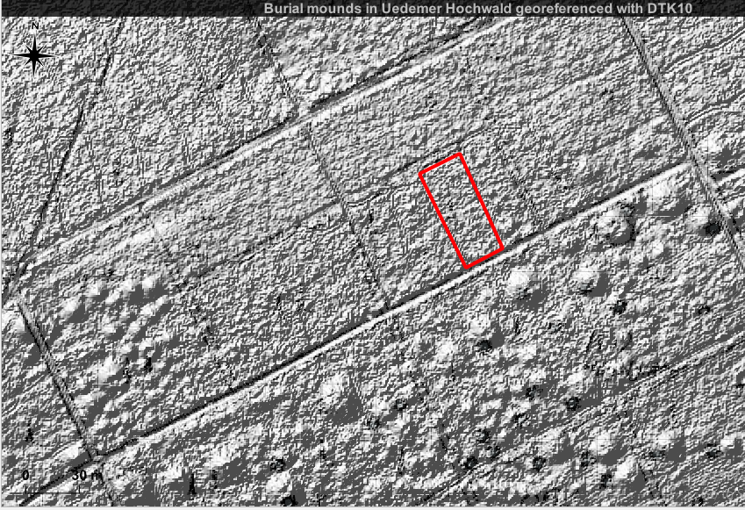
Sub-Task 3.4: Study the hillshade model in direction East-North-East of the burial mounds area and search for weakly visible rectangular structures which are not paths. Choose at least one of the structures, digitize it with a polygon and save it as a geopackage.

Slide 26
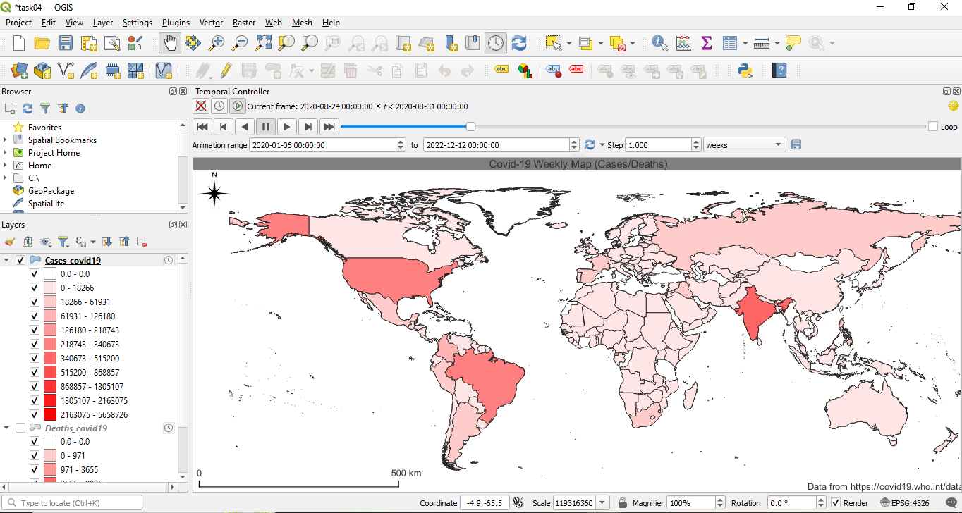
Task04: Choropleth Covid-19 Worldwide Animated Map 2020-2022

Slide 27
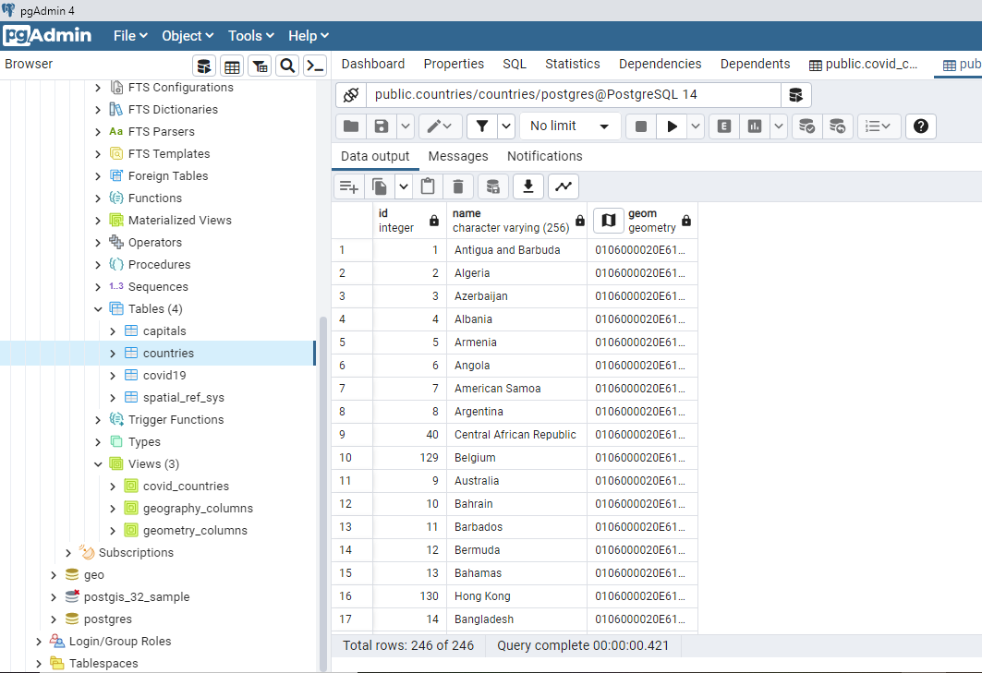
Task04: Choropleth Covid-19 Worldwide Animated Map 2020-2022

Slide 28
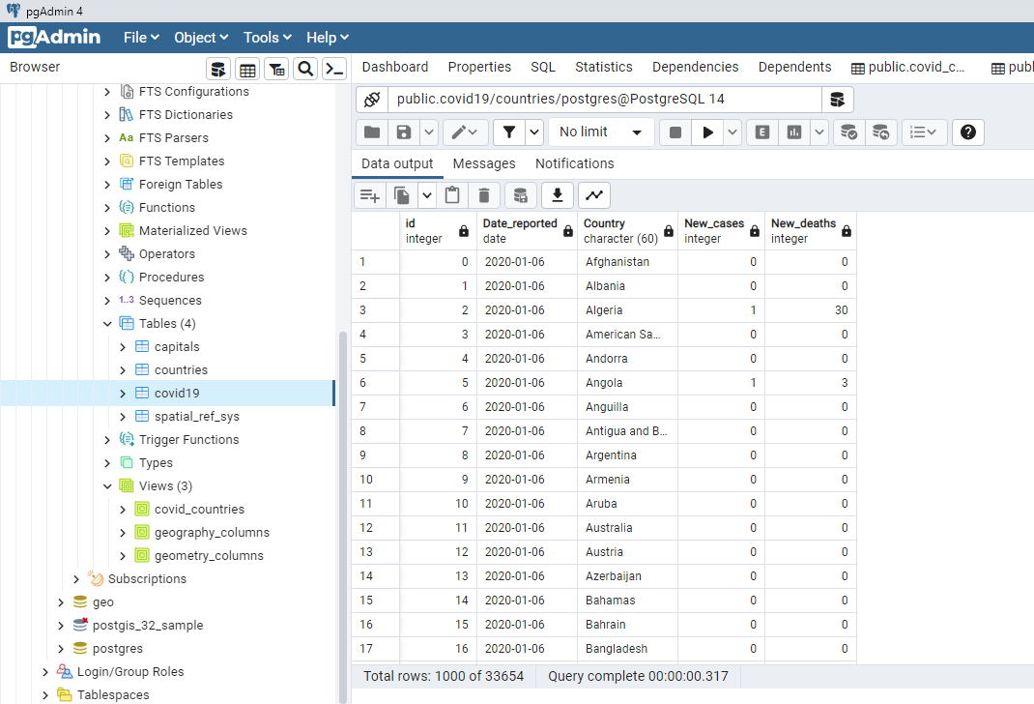
Task04: Choropleth Covid-19 Worldwide Animated Map 2020-2022

Slide 29
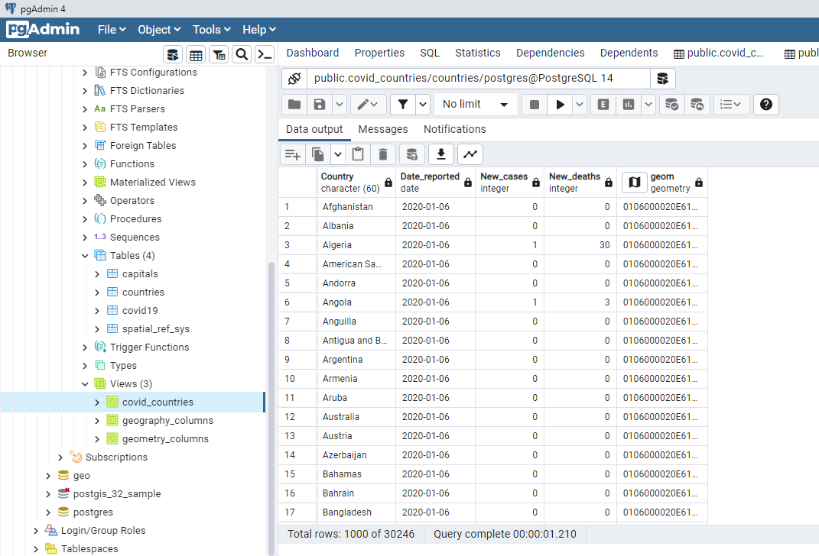
Task04: Choropleth Covid-19 Worldwide Animated Map 2020-2022

Slide 30
Your Personal View
Biggest challenges?
Lessons learned?
Whatever you want to say related to course

Slide 31
Self-Assessment
What is your personal knowledge gain?
[1-5]
How do you rate your commitment?
[1-5]
How difficult is your task?
[1-5]

Slide 32
Thank you for your attention
Fundamentals of Geodata Management Systems
Ziad helou
29926

